Slide 1
Transients identification basing on PDG (permanent downhole gauge) pressure data
Lejun Chen
Supervisors: Prof. Chunming Rong
Dr. Anton Shchipanov

Slide 2
Outlines
Methods in last two decades
Algorithms, detecting steps, user input, prerequisites
Experiments results of these methods
Summarization of these methods
Baseline methods that I developed
A naive attempt need improvement
Job ahead
Explore advanced methods: e.g. feature-based machine learning, predefine pattern recognition, etc.
Web-application for testing real field data

Slide 3
Methodology for analysis of PDG data (proposed by Athichanagorn 1999)
Outlier removal and denoising
Data reduction
Transient identification main task
Flow history reconstruction
Behavioural filtering
Data interpretation

Slide 4
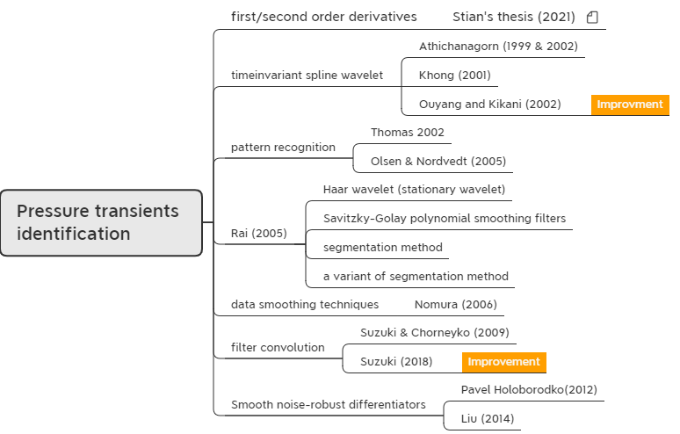
Methods investigated

Slide 5
Time invariant spline wavelet
Athichanagorn (1999 & 2002)
Use wavelet multilevel signal decomposition
Detect algorithm:
The wavelet modulus maxima at different levels of decomposition
The characteristics of wavelet modulus maxima
High level: signal singularities are group as a single singularity
Low level: signal singularities and noise singularities both present
Intermediate level: only signal singularities present detect this level
Note: intermediate level may vary for different datasets

Slide 6
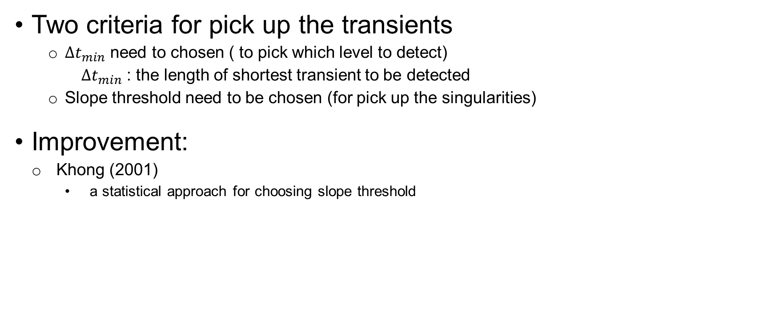
Time invariant spline wavelet
Two criteria for pick up the transients
$∆t_{min}$ need to chosen ( to pick which level to detect)
$∆t_{min}$ : the length of shortest transient to be detected
Slope threshold need to be chosen (for pick up the singularities)
Improvement:
Khong (2001)
a statistical approach for choosing slope threshold

Slide 7
Time invariant spline wavelet
Detecting steps:
Determine which level should be used in the detection algorithm based on the desired resolution of the results.
Choose a slope threshold to discriminate between singularities corresponding to new transients and noise singularities.
Determine possible locations for starting positions of new transients by choosing wavelet modulus maxima whose detail signals are higher than the threshold and map the positions back to the original resolution.
Check whether the slope extending from the singularity point forward is higher than the slope threshold and whether it deviates from the slope of data prior to the point of singularity.
Determine the exact location of the beginning of a new transient by computing the intersection between a line that passes through the first two points in the new transient and another line passing through the last two points in the previous transient.

Slide 8
Pattern-recognition approach
Thomas (2002)
Identify aberrant transients
Olsen & Nordvedt (2005)
Extend to identify normal transients

Slide 9
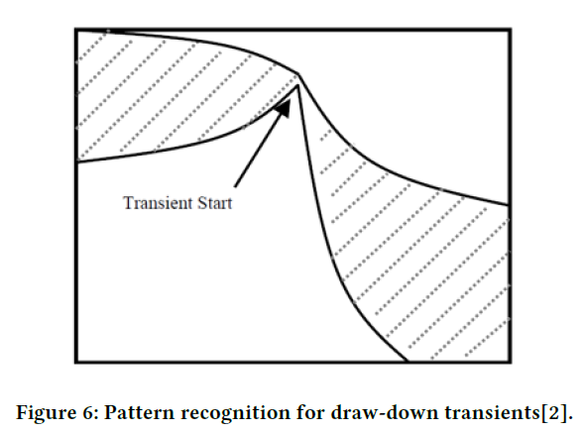
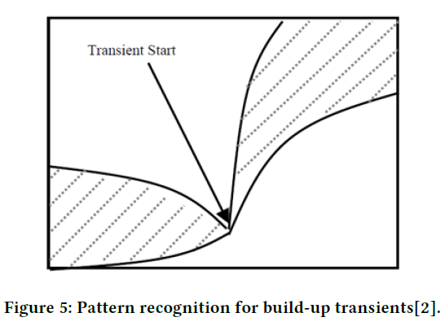
Pattern-recognition approach
Two ways to determine the pattern for break points
To predefine a pattern. ← used by Olsen & Nordvedt
To use a system learning process, like neural networks, to train the system for pattern recognition.

Slide 10
Pattern-recognition approach
Three prerequisites
Outliers must be removed.
Denoising is recommended especially when the noise level is large.
Not to use a noise filter that will seriously over smooth the transients.

Slide 11
Four methods by Rai (2005)
Four methods:
Haar wavelet (Stationary wavelet) perform similar as spline wavelet
Savitzky-Golay polynomial smoothing filters
Segmentation method significant improvements
A variant of segmentation method

Slide 12
Savitzky-Golay FIR smoothing filters
Basic idea:
Denoising the data with Savitzky-Golay filter.
Identify the breakpoints utilizing first-forth derivative.
Threshold for choosing the peak is needed.

Slide 13

Savitzky-Golay FIR smoothing filters
Algorithm for S-G filter:
A type of digital filter that replaces each data value 𝑓𝑖 by a linear combination 𝑔𝑖 of itself and some number of nearby neighbours
Similar with moving average, but not take the average
To approximate the underlying function within the moving window not by a constant (whose estimate is the average), but by a polynomial of higher order.
Note: Python has S-G filter library ready to use

Slide 14
Savitzky-Golay FIR smoothing filters
Detecting steps:
Find the peaks above a certain low threshold in the first derivative of pressure or rate data.
A backward search is carried out for identifying the corresponding peaks in the second, third and fourth derivatives of the data.
Interpolation between these locations is carried out by checking the slopes between each pair of locations to be higher than a certain value.

Slide 15
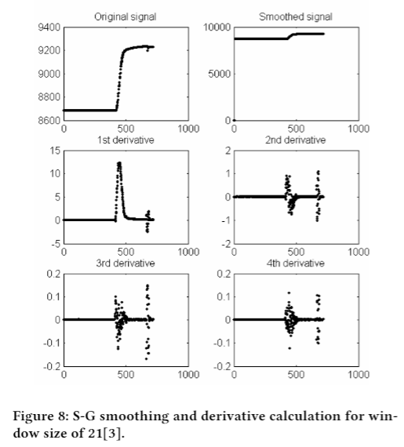
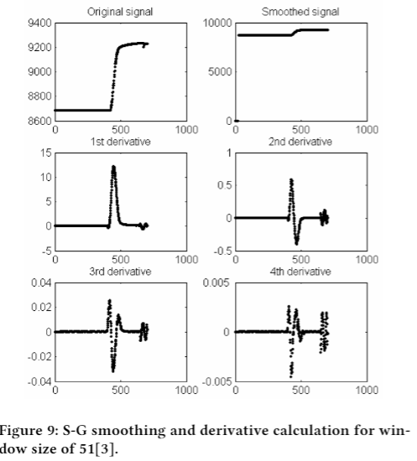
Savitzky-Golay FIR smoothing filters
Smoothing and derivative calculation for different window size:
Window size 21 window size 51
Better choice!

Slide 16
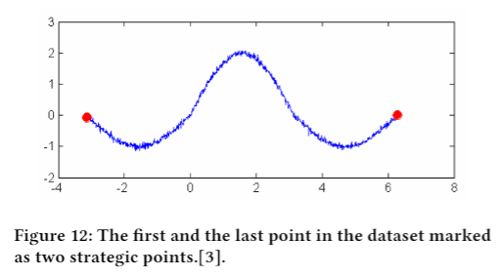
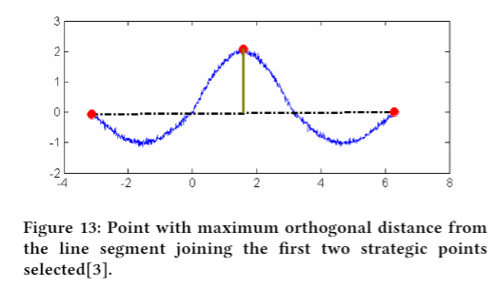
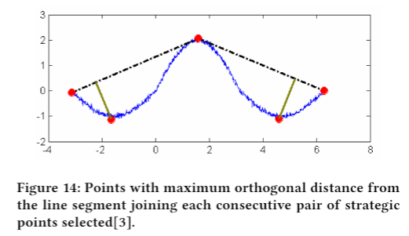
Segmentation method
Detecting algorithm
The first step is to collect a set of strategic points, by solving a sequence of maximum orthogonal (Euclidean) distance problems.

Slide 17
Segmentation method
Detecting algorithm
The second step is to calculate the area under each strategic point by considering the two other strategic points to its either side. The small or false breakpoints are then deflated using a very small area cut-off which is taken as a very small fraction of the highest area in the dataset.
The third step is to screen further by checking the forward and backward slope. As a rule of thumb, if the forward slope is less then half the backward slope, the point is discarded. The slopes were obtained by least square fitting.

Slide 18
Variation of Segmentation method
Basic idea
Identifies the zeros in the flow rate.
Between two consecutive zeros finds the peak using the segmentation approach.

Slide 19
Data smoothing techniques
Nomura (2006)
Detection algorithm
(Treat as pressure fitting problem)
Initial guess
(from wavelet processing result)
Insert break points
Delete break points

Slide 20
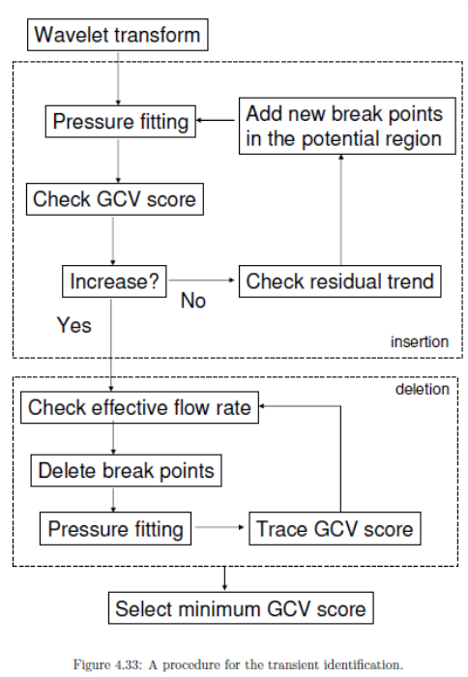
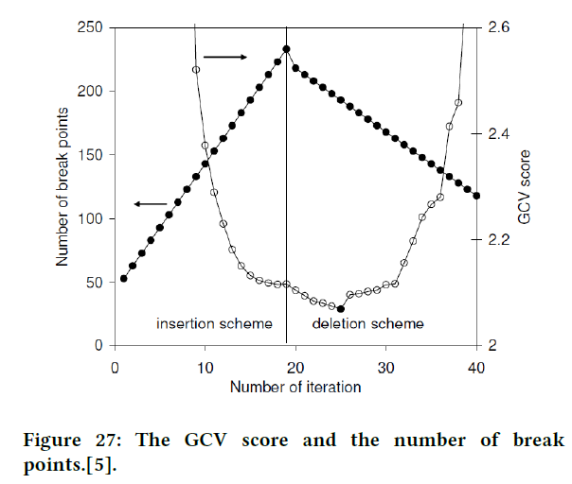
Data smoothing techniques

Slide 21
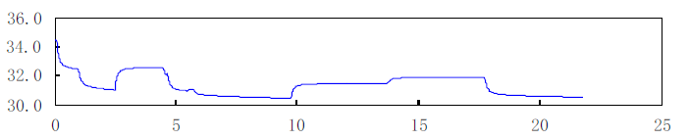
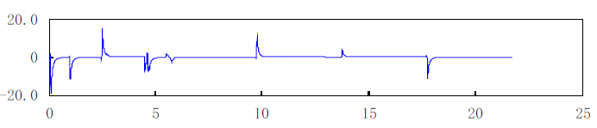
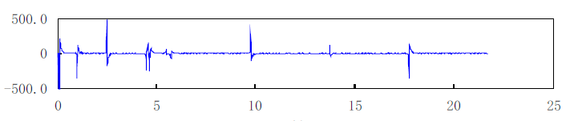
Smooth noise-robust differentiators
Pavel (2012)
Liu (2014)
Original Pressure data
First order derivative
Second order derivative

Slide 22
Filter convolution
Suzuki & Chorneyko (2009)
Suzuki (2018)
Improvement

Slide 23
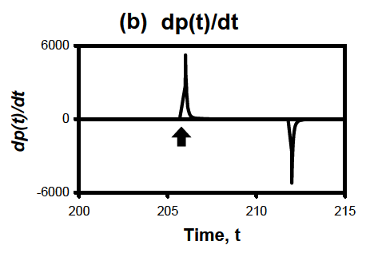
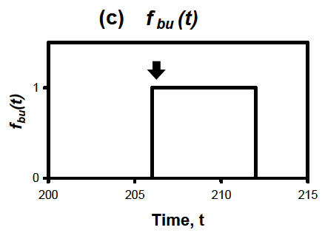
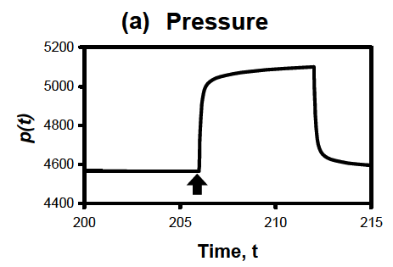
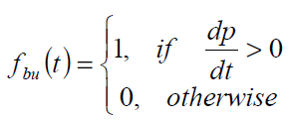
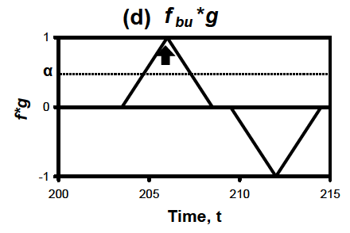
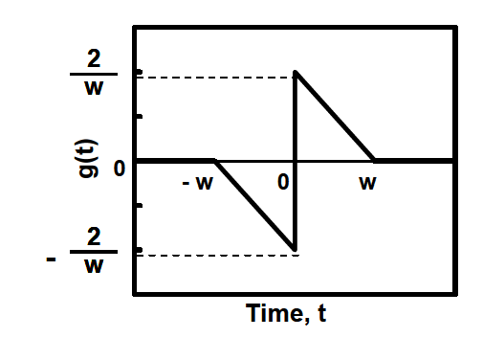
Filter convolution
Original signal Slope of pressure signal Indicator function of slope
Detecting algorithm
Convolution Filter function

Slide 24
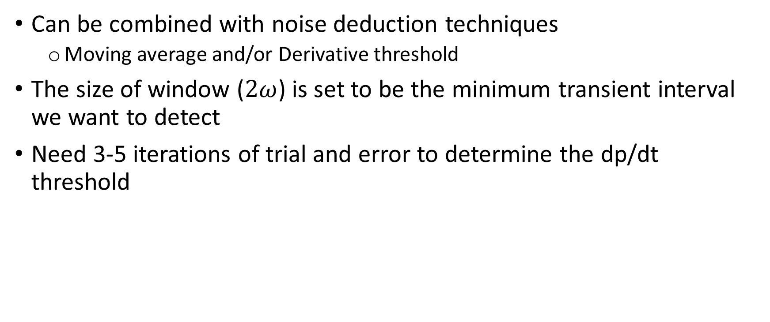
Filter convolution
Can be combined with noise deduction techniques
Moving average and/or Derivative threshold
The size of window ($2ω$) is set to be the minimum transient interval we want to detect
Need 3-5 iterations of trial and error to determine the dp/dt threshold

Slide 25
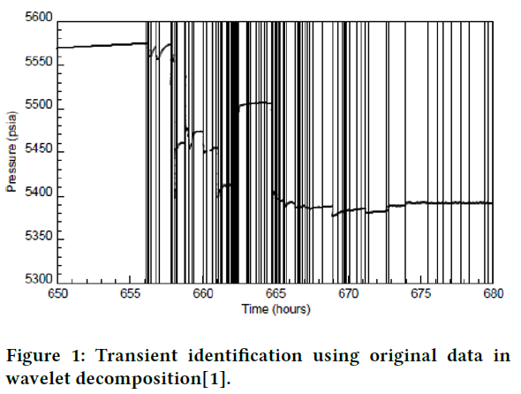
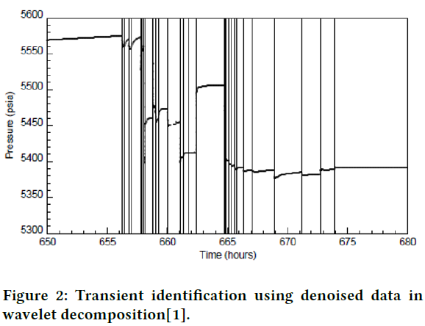
Comparison of results
Time invariant spline wavelet

Slide 26
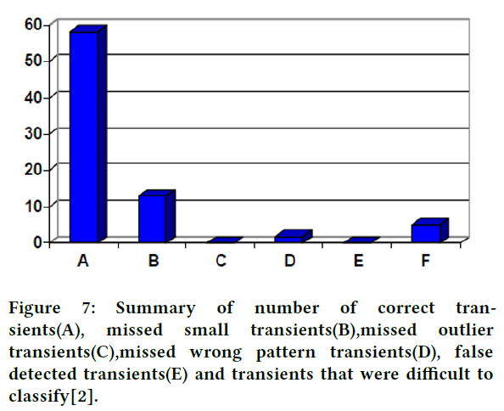
Comparison of results
Pattern-recognition

Slide 27
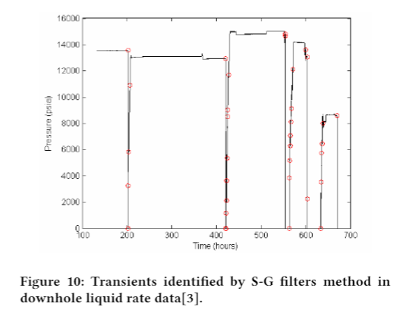
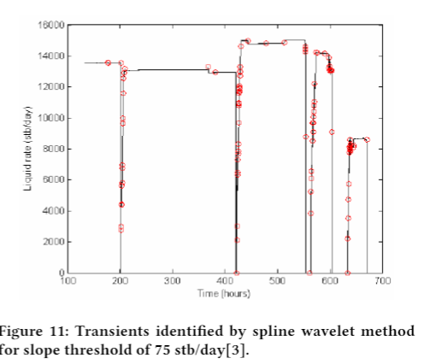
Comparison of results
Savitzky-Golay FIR smoothing filters

Slide 28
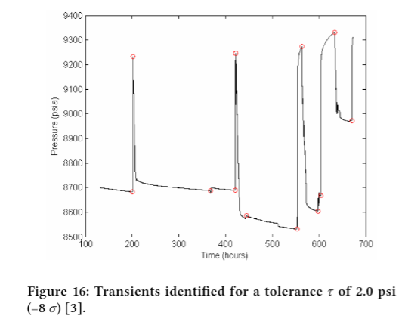
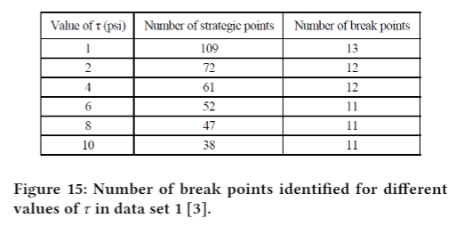
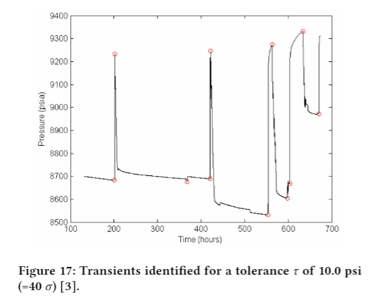
Comparison of results
Segmentation method

Slide 29
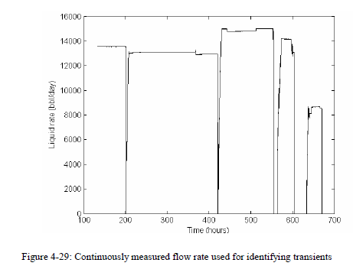
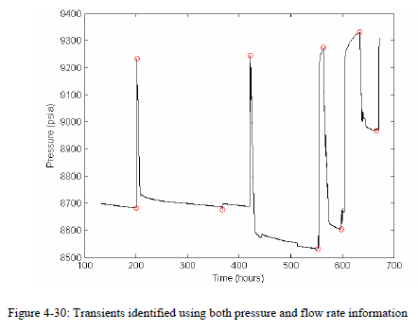
Comparison of results
Variation of Segmentation method

Slide 30
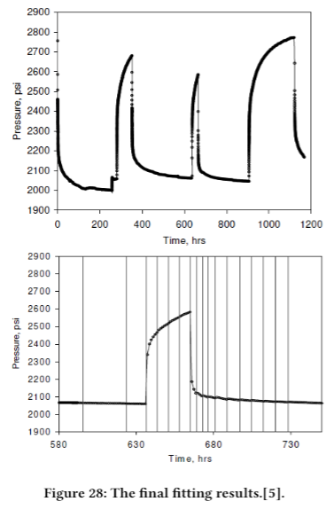
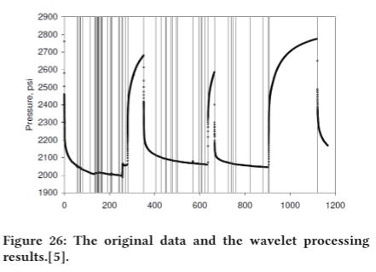
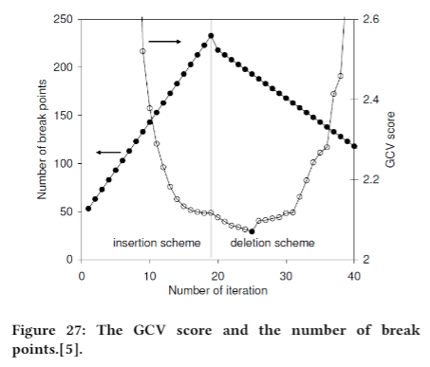
Comparison of results
Data smoothing

Slide 31
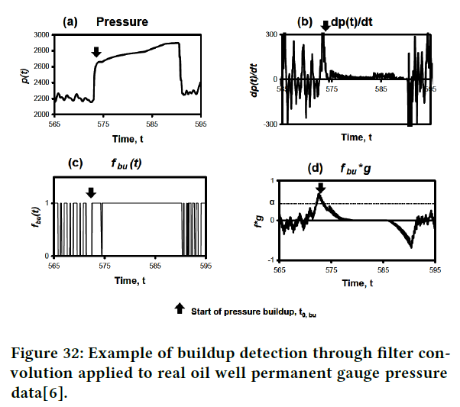
Comparison of results
Filter convolution
(real oil well)
Interesting characteristics:
The time duration of slop value larger than zero or small than zero

Slide 32
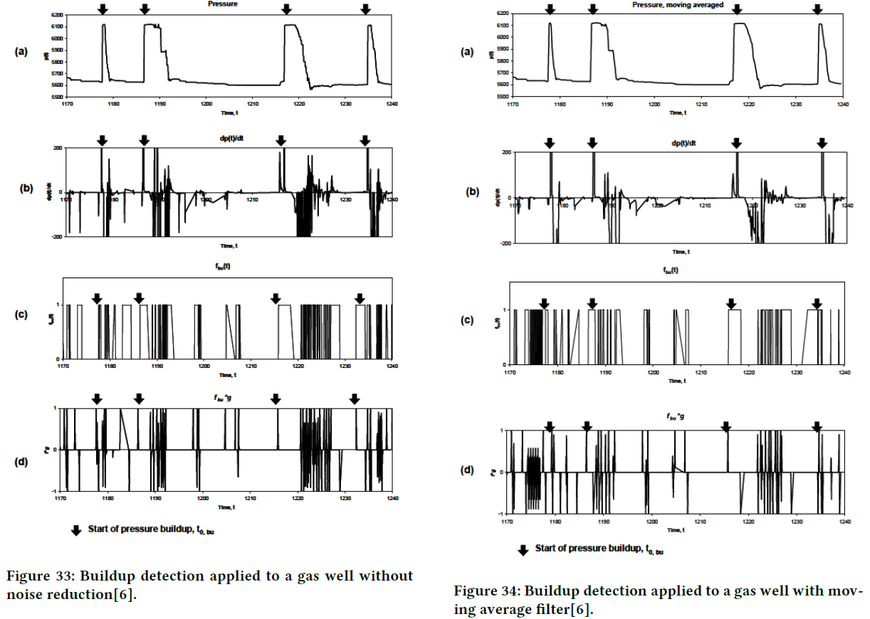
Comparison of results
Filter convolution
(real gas well)
More challenging!

Slide 33
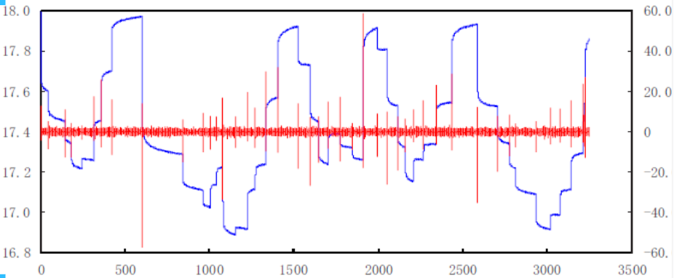
Smooth noise-robust differentiators
Pavel (2012)
Liu (2014)
Experiment result (synthetic data)

Slide 34
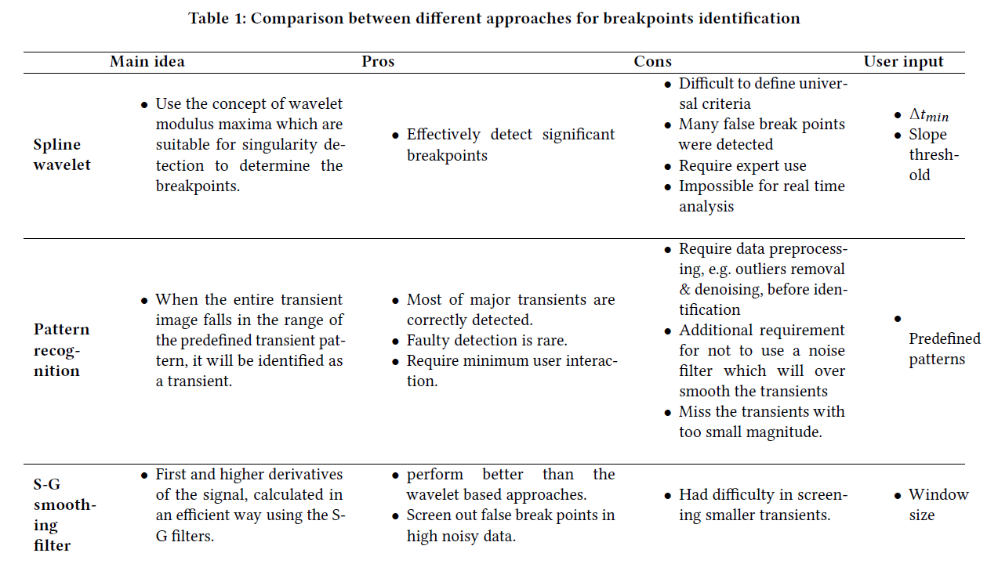
Summarization(1)

Slide 35
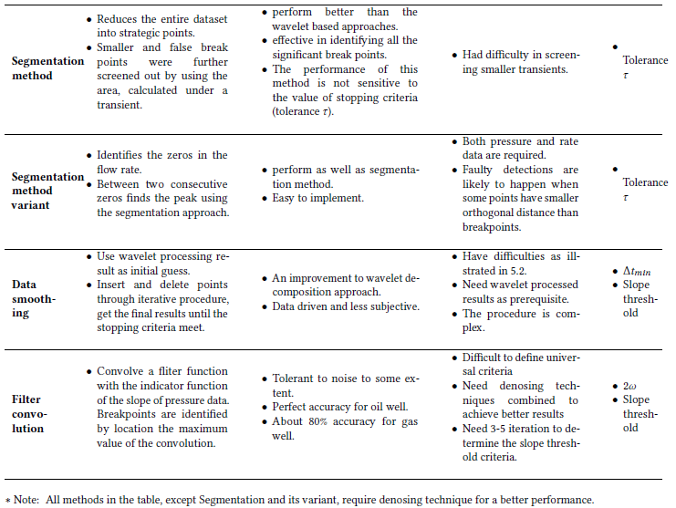
Summarization(1)

Slide 36
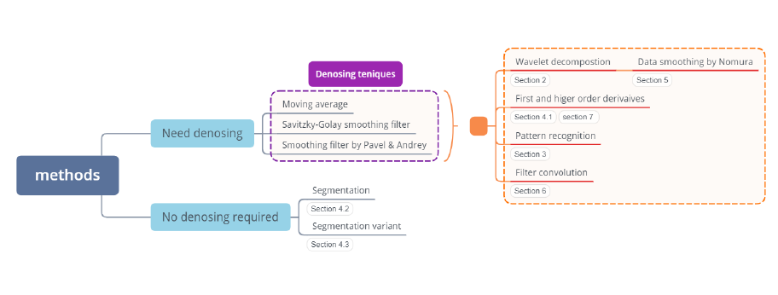
Summarization(2)

Slide 37
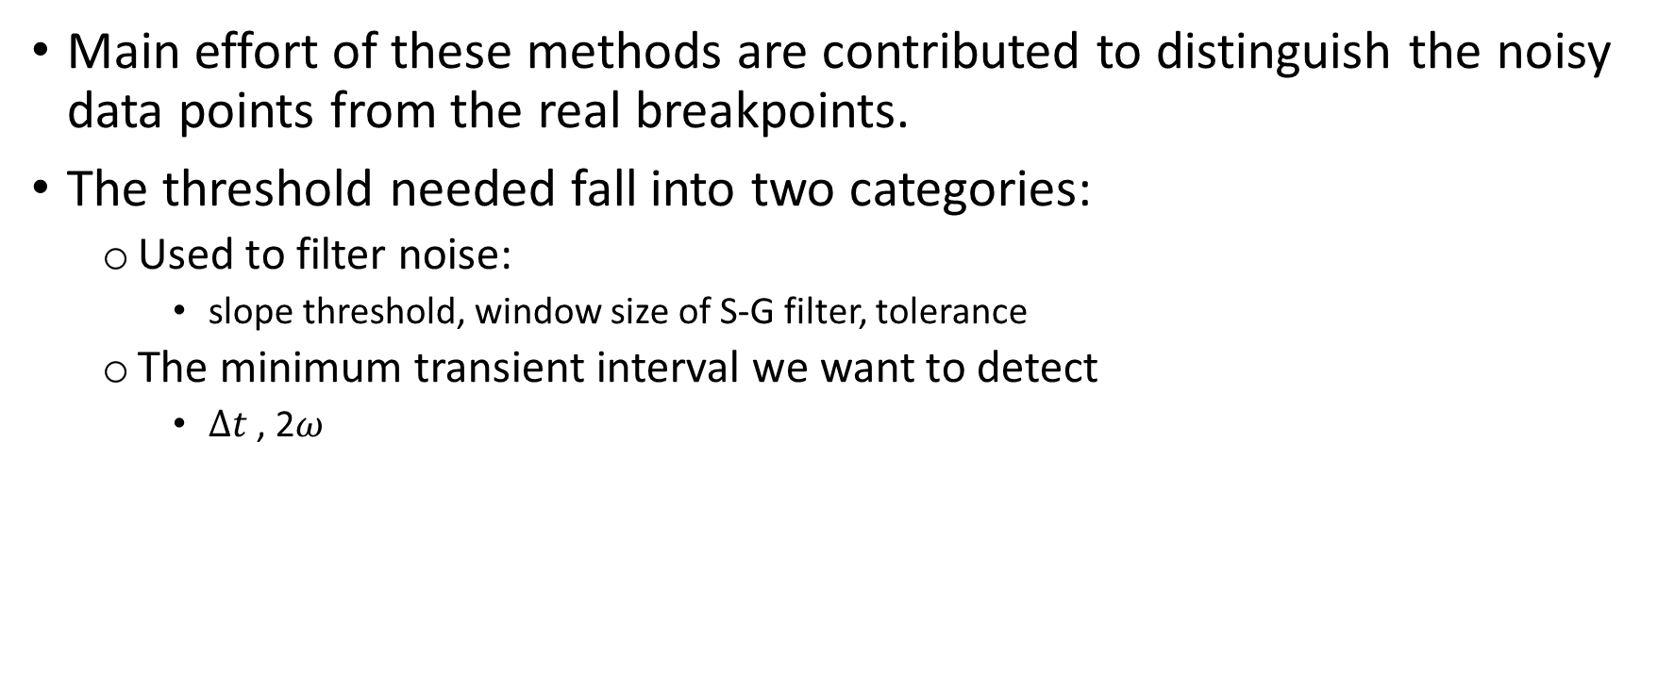
Summarization(3)
Main effort of these methods are contributed to distinguish the noisy data points from the real breakpoints.
The threshold needed fall into two categories:
Used to filter noise:
slope threshold, window size of S-G filter, tolerance
The minimum transient interval we want to detect
$∆t$ , 2$ω$

Slide 38
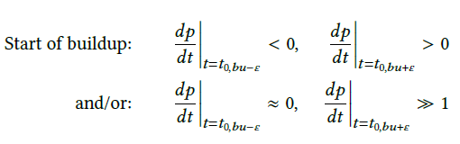
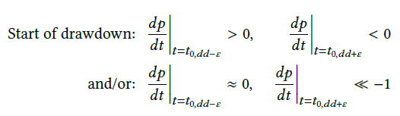
Baseline methods:
Criteria for deciding breakpoints:
If there exists two points:
the sign of first order derivative are different
The difference of first order derivative is larger than a certain threshold
Then, the latter point is a breakpoint.
Note:
Empirical threshold value: 2.5 std
Works well with synthetic data, but not for real data because of NOISE!
Basic idea (a naive attempt):
(3) Set the sign of first order derivative of later point as same as the previous one, if the difference of slope between them is smaller than a threshold

Slide 39
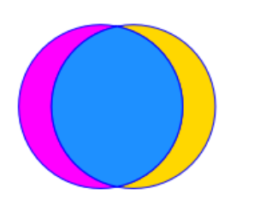
Baseline methods:
Test with synthetic data
Synthetic data
6000 hours
Pressure: 3519 measurements
Flow rate: 95 measurements
Experiment result interpretation
points
correct
points
faulty
points
missed
detected
points
ground
truth

Slide 40
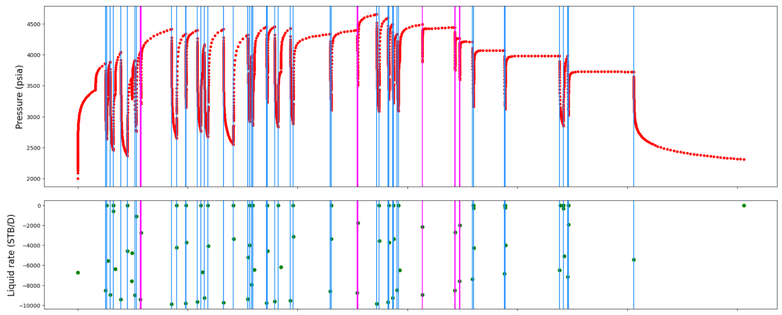
Baseline methods
Test with synthetic data
Total detected breakpoints: 57

Slide 41
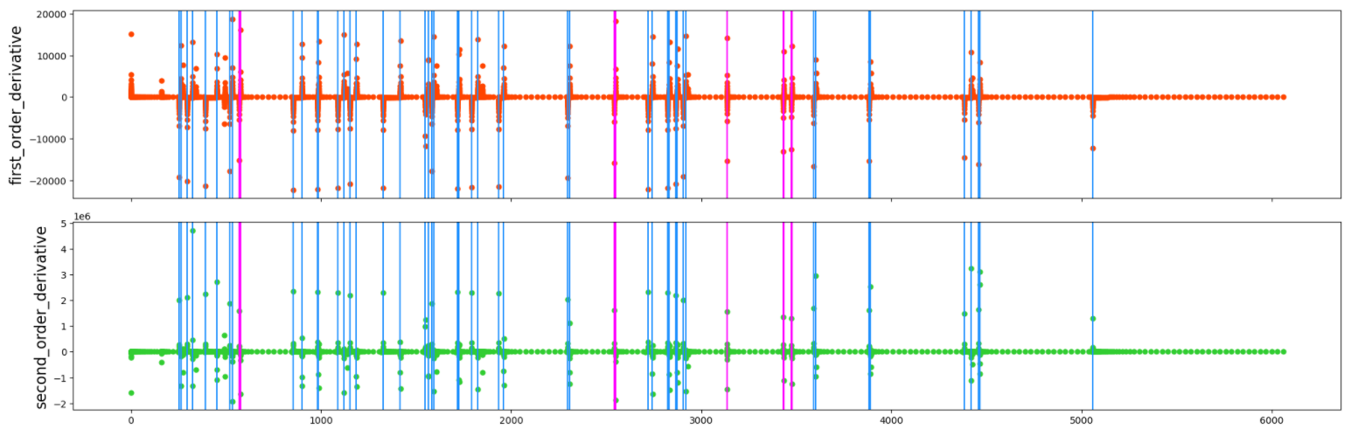
Baseline methods
Test with synthetic data

Slide 42

Baseline methods
Test with synthetic data
Ground truth: 45
Statistics plot for experiment result
Total detected breakpoints: 57
Points correct: 45
Points faulty:12
Points missed: 0
detected
points
ground
points

Slide 43
Baseline methods:
Test with real field data
Real field data
4070 hours
Pressure: 29813 measurements
Flow rate: 10191 measurements
Experiment result interpretation
points
correct
points
faulty
points
missed
detected
points
ground
truth

Slide 44
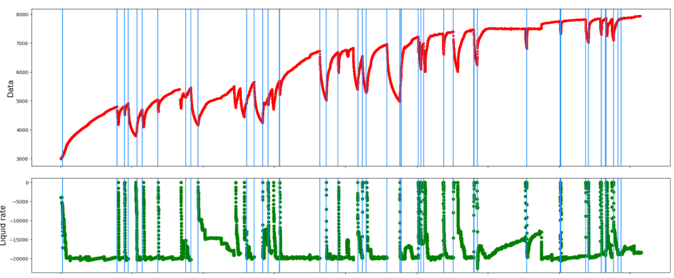
Baseline methods
Detected breakpoints: 72

Slide 45
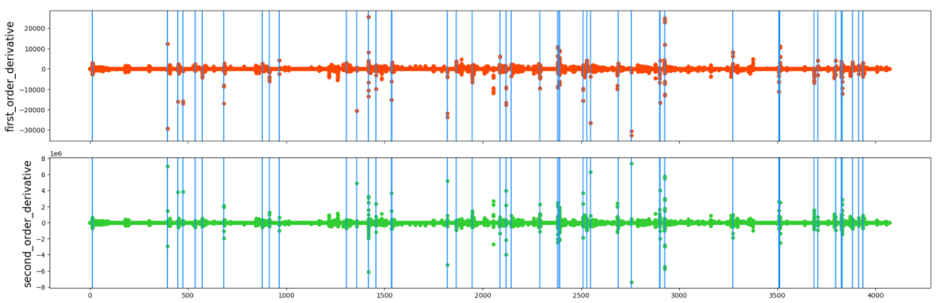
Baseline methods
Detected breakpoints: 72

Slide 46
Baseline methods
Pros:
Identify most of the main transients towards synthetic data
Do not require denosing
Calculation cheap
Cons:
Have many faulty detections for real field data
Difficult to filter the points where the flow rate decrease but not shut in
Need threshold
The value of threshold has a great influence to the performance

Slide 47
Job ahead (advanced methods)
Machine learning --- Feature extractions
Inspired by the methods investigated
first to forth derivatives of pressure data, estimated noise(S-G filter method)
the time duration the first derivative larger(or smaller) than zero (filter convolution method)
Backward and forward slope of two adjacent detected breakpoints, slopes were obtained by least square fitting (segmentation methods)
Feature selection criteria
Realtime
Case independent (require less or no expert use)
The one that brings minor improvement will be discarded
Computational cheap

Slide 48
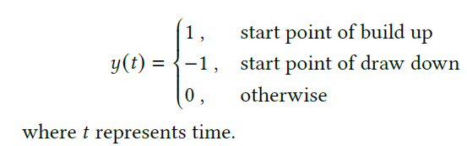
Job ahead (advanced methods)
Machine learning --- label
Generate Label
Results from the baseline methods
validate with flow rate

Slide 49
Job ahead (advanced methods)
Machine learning –classical methods
Split the data to train and test set following 80/20 rule
Cross validation, K-means, etc.
Experiment with different classifiers

Slide 50
Job ahead (advanced methods)
Machine learning
Pros:
Higher accuracy
Cons:
More computation

Slide 51
Thanks ☺
Any comments?

Slide 52
An idea for using machine learning
How to extract features?
Need careful analysis and investigation.
Some preliminary ideas
Based on different algorithm, different features will be extracted.
S-G filter: first to forth derivatives, maybe fifth needed, estimated noise, window size also matters?
Filter convolution: first derivative, convolution value, estimated noise, the time duration the first derivative larger(or smaller) than zero, parameter of filter functions also matters??
Maybe above two methods can be combined…
Other methods?

Slide 53
Questions
Which method to chose?
Simplicity
Accuracy
Our real case data
Outlier removed?
Denoised?
A naive thinking
Use the reconstructed flow rate data (Anisa 2020) to identify the pressure transient

Slide 54
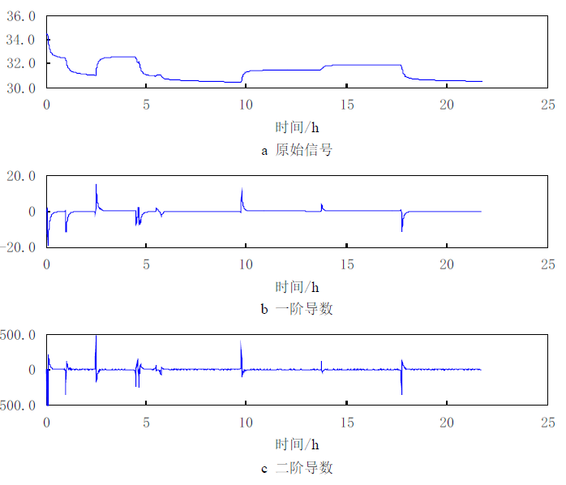
Original signal
1st derivative
2nd derivative

Slide 55


Challenges of PDG data
Rate Transient Analysis (RTA)
Need low frequency extraction
1,000 points extracted on a logarithmic time scale will be suitable for analysis
Pressure Transient Analysis (PTA)
Need high frequency extraction
1 pressure point per hour is more than enough

Slide 56


Wavelet filtration

Slide 57


Wavelet filtration

Slide 58


Slide 59
Four methods by Rai (2005)
Name | Pros | Cons
Haar wavelet | same as spline wavelet | same as spline wavelet
Savitzky-Golay polynomial smoothing filters | identifying most of the true break points retaining fewer small and false break points screen out false break points in regions of high noise variance | difficulty in screening some smaller transients that are contained in the significant transients.
segmentation method | very effective in identifying all the significant break points retaining very few smaller transients the range of stopping criterion is relatively wide
a variant of segmentation method | perform as well as segmentation method | require both flow rate and pressure data

Slide 60

Time invariant spline wavelet
Pros
Effectively detect significant breakpoints
Cons
Difficult to define universal criteria
$∆t_{min}$ & Slope threshold
Many false break points were detected
Small transients were missed
Require expert use
Impossible for real time analysis

Slide 61
Data smoothing techniques
Pros:
Experiment result is effective
Data driven and less subjective
A consistent manner
Cons:
Need to process data using the wavelet first
More complex
Two difficulties
The insertion and deletion scheme is not guaranteed to produce the best result.
The GCV minimization is not guaranteed to always produce a reasonable model due to the lack of local information.

Slide 62
Smooth noise-robust differentiators
Pros
Robust to noise
Detect large transients as well as minor ones
No need to denoising the data
Simple algorithm

Slide 63
Filter convolution
Pros:
Robust to noise
Perfectly accurate for oil well
Cons:
More challenging for gas well
Need 3-5 iteration to determine the criteria
Need outliers removal and denoising before identification

Slide 64



Baseline methods:
Start point:
$\frac{dp}{dt}>threshold$
Empirical threshold value: 2.5 * std
Synthetic pressure data real case pressure data

